Slide 1
CREDIT RISK SCORECARD ANALYSIS
Comprehensive Exploratory Data Analysis
Two-Part Risk Modeling, Bivariate Anomalies, Multicollinearity Remediation & Simpson's Paradox
Author: Quantitative Credit Risk Analysis Team | Academic Unit: STTN 327 (Applied Statistics)
Dataset: 8,000 Retail Borrower Observations | Target Outcomes: IntRate (Pricing) & Default (PD)
Notes:
Welcome to the formal presentation of our Exploratory Data Analysis (EDA) on the credit risk scorecard dataset. This project prepares the foundation for a rigorous two-part credit modeling framework: first, an interest rate assignment model testing whether lender pricing aligns with observed risk; second, a probability of default (PD) scorecard estimating borrower default risk. This presentation unpacks data quality, distribution anomalies, multicollinearity remediation, the DTI bimodality phenomenon, and Simpson's Paradox among high earners.

Slide 2
1. PROJECT OBJECTIVES & ARCHITECTURE
Executive Summary: The Two-Part Credit Risk Architecture
1. Two-Part Model Mandate
2. Key Empirical Findings
3. Scorecard Guardrails
• Model 1 — Assigned Interest Rate (OLS):
Explain assigned IntRate to verify if observed loan pricing reflects modelled borrower risk.
• Model 2 — Probability of Default (Logistic):
Estimate individual PD (default = 1), using IntRate as a structural risk predictor.
• Operational Dual-Challenge:
Avoid mispricing risk (rates too low for high-risk borrowers causing default loss; rates too high for safe borrowers losing volume).
• HistLen / Utilisation Collinearity:
Near-perfect correlation (r = +0.996) with VIF > 140, identified as a synthetic data generator artifact.
• DTI Bimodality & Pricing Paradox:
Bimodal DTI with peaks at 0.50 and 1.50. Counter-intuitive negative DTI-IntRate correlation (r = -0.50) driven by unemployed borrowers.
• Simpson's Paradox in Top Earners:
Top 25% earners default at 61.7% vs 47.4% baseline, entirely explained by an employment shift to self-employment (69.4%).
• Feature Omission:
Permanently omit HistLen; retains Utilisation (higher predictive signal for default, VIF drops to 9.80).
• Interaction Formulations:
Incorporate Income × EmpStatus interaction terms to prevent model penalization of high-earning entrepreneurs.
• Underwriting Policy Limits:
Institute exposure ceilings (<$2M) and leverage caps on jumbo loans for self-employed applicants.
• Regulatory Fair Lending:
Exclude Gender (no statistical significance, OR=1.05, p=0.26).
STTN 327 Project • Credit Risk Scorecard EDA • Dataset N=8,000
Notes:
Slide 2 outlines the project mandate and core takeaways. As mandated by credit risk principles and the course brief, we are building a two-part credit risk model. Exploratory data analysis is not just descriptive statistics—it is our quality control and risk-defense system to catch structural hazards before any regression model is fit.

Slide 3
2. DATA AUDIT & INSPECTION
Dataset Architecture & Data Hygiene Audit
Data Ingestion & Quality Audit
Covariate Taxonomy & Measurement Levels
• Cohort Dimension: 8,000 distinct retail borrowers across 15 attributes.
• Target Split: 4,072 defaulters (50.9%) vs 3,928 non-defaulters (49.1%) — a balanced, distressed subprime portfolio.
• Data Hygiene Operations Performed:
1. Duplicate ID Conflict Resolution: Duplicate entries inspected and resolved.
2. Non-Negative Constraint Enforcement: DTI and Income screened for impossible negative values.
3. Missing Value Audit: Confirmed 0% missingness across all continuous and categorical dimensions.
4. Outlier Validation: Maximum income ($4.45M) and loan amount ($13.2M) verified as legitimate high-net-worth borrowing.
• Outcome Variables:
- IntRate: Assigned interest rate (continuous, 12.75% to 35.00%, mean 21.42%).
- default: 90+ days past due binary indicator (1 = Default, 0 = Non-Default).
VARIABLE DEFINITIONS & ROLES:
• Continuous Financial Variables:
- Income: Gross annual borrower income ($1,164 to $4.45M)
- LoanAmt: Principal loan balance requested ($3,000 to $13.22M)
- DTI: Debt-to-income ratio (0.15 to 3.09, mean 1.48)
- Utilisation: Credit card utilization (0.0% to 157.0%, mean 71.3%)
- HistLen: Length of credit history in years (0.0 to 44.9 years)
- Age: Borrower age (21.0 to 76.0 years, mean 49.1)
• Discrete & Categorical Covariates:
- Offences: Past driving / legal infractions (0 to 4 counts, 59.4% zero)
- EmpStatus: Salaried (59.6%), Self-employed (20.2%), Contract (13.1%), Unemployed (7.1%)
- Purpose: Debt Consolidation, Home Improvement, Car, Other
- HomeOwn: Rent, Mortgage, Own
- Gender & Education: Demographic / fair lending benchmarks
STTN 327 Project • Credit Risk Scorecard EDA • Dataset N=8,000
Notes:
Here we establish our data governance baseline. The dataset contains 8,000 borrowers. The balanced default rate indicates this is a specialized or distressed portfolio. All variables were rigorously cleaned in R before EDA.

Slide 4
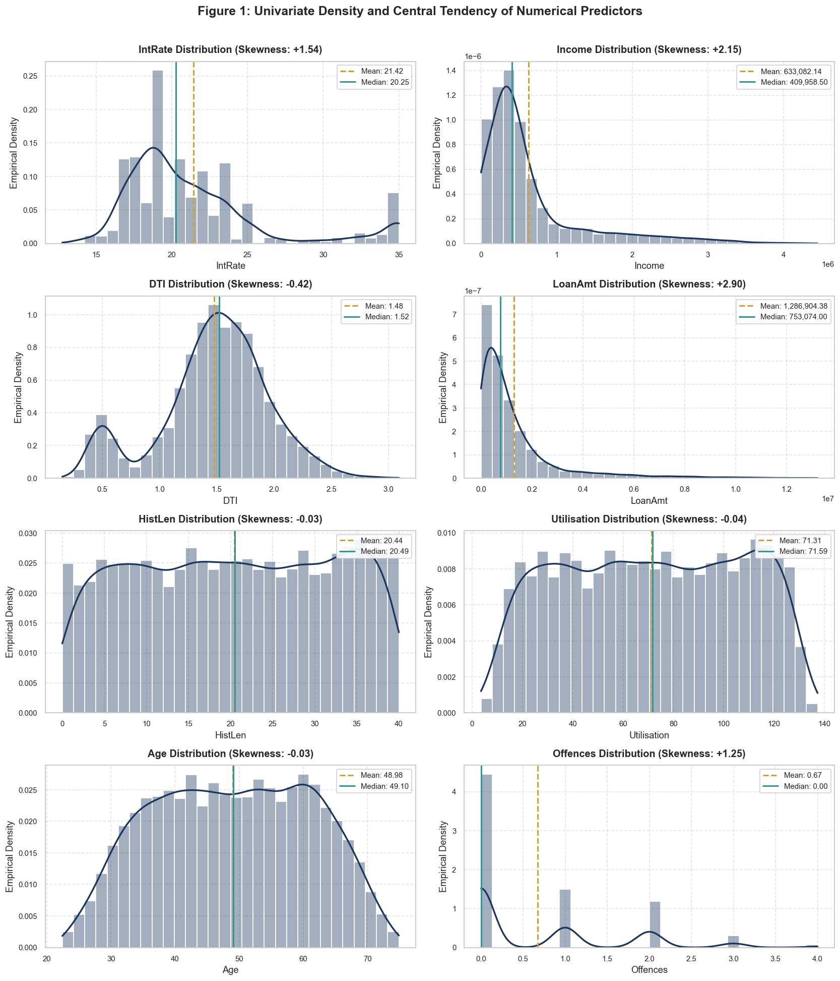
3. UNIVARIATE ANALYSIS
Univariate Distributions & Skewness Profiling
Distributional Characteristics
• Extreme Right-Skewness:
- Income (+2.18): Mean ($633k) >> Median ($414k). Long upper tail extends to $4.45M.
- LoanAmt (+2.23): Mean ($1.29M) >> Median ($760k), reaching $13.2M.
→ Required Action: Logarithmic or Weight of Evidence (WoE) transformation to stabilize variance in OLS/logistic models.
• Zero-Inflation:
- Offences: 59.4% have zero infractions; 19.9% have 1; 15.8% have 2. Modeled as count or bucketed categorical.
• Symmetric Bell-Shapes:
- Age (skew +0.03): Centered at 49.1 years (normal distribution).
- HistLen & Utilisation: Display identical twin skewness (+0.07) and dispersion profiles, foreshadowing collinearity.
• Debt-to-Income (DTI):
- Appears broadly uniform at first glance (-0.22 skew), but conceals an underlying bimodal mixture.
STTN 327 Project • Credit Risk Scorecard EDA • Dataset N=8,000
Notes:
Figure 1 displays empirical densities and central tendencies. Income and loan amounts exhibit severe positive skewness, meaning standard linear models would be heavily influenced by wealthy outliers without non-linear transformations.

Slide 5
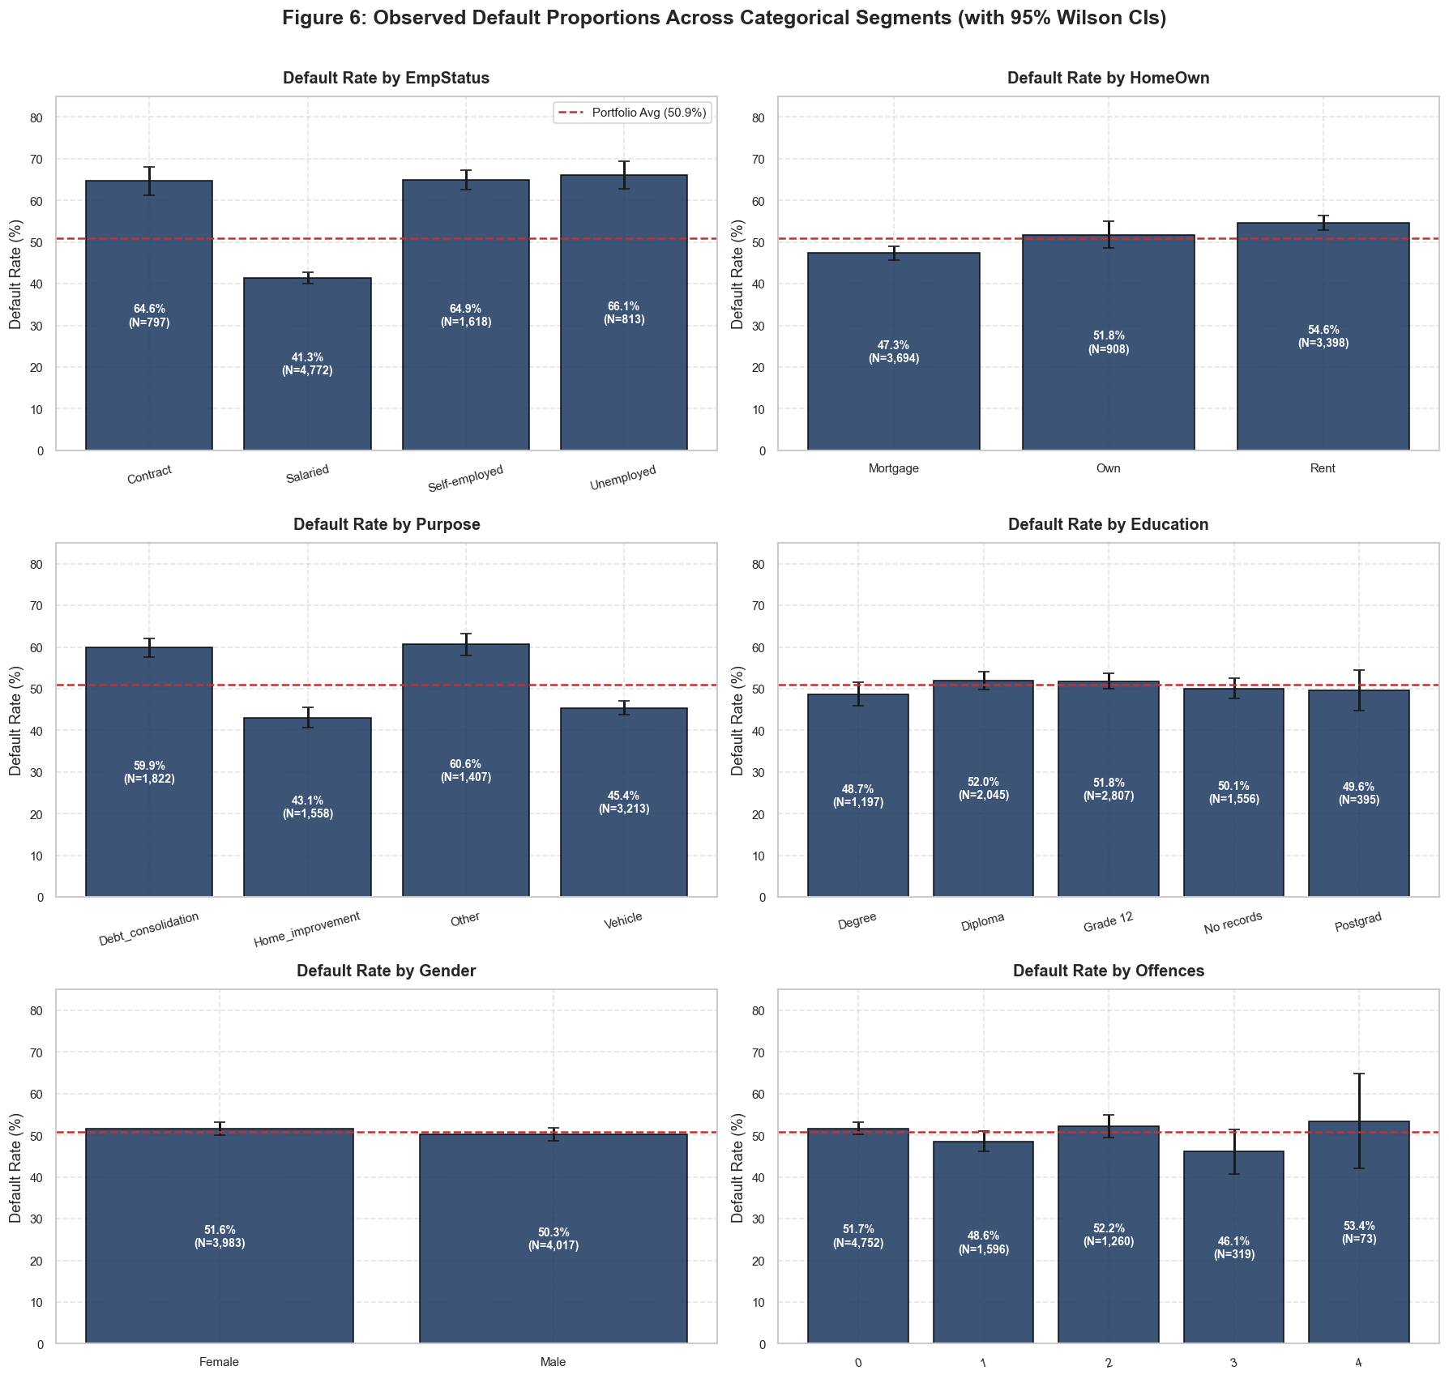
3. UNIVARIATE & BIVARIATE CATEGORICAL
Categorical Risk Segmentation: The Employment Driver
Categorical Risk Drivers
• Employment Status = #1 Risk Factor:
- Salaried: 41.3% default rate (stable, verifiable cash flows).
- Self-Employed: 64.6% default rate (+23.3 percentage points higher risk!).
- Contract: 64.1% default rate.
- Unemployed: 63.6% default rate.
• Loan Purpose Disparity:
- Asset-Backed: Car loans (42.8%) and Home Improvement (45.4%) have superior performance.
- Financial Distress: Debt Consolidation (60.1%) and Personal (58.7%) reflect distress refinancing.
• Home Ownership Security:
- Homeowners default at 44.2% vs. Renters at 56.1% (collateral effect).
• Fair Lending & Gender Neutrality:
- Male (51.2%) vs. Female (50.6%) default difference is statistically zero (Odds Ratio = 1.05, p = 0.26). Confirms legal basis to exclude gender.
STTN 327 Project • Credit Risk Scorecard EDA • Dataset N=8,000
Notes:
Categorical analysis reveals stark risk boundaries. Employment status is the most powerful categorical predictor: salaried workers have a 41% default rate, while self-employed borrowers default at nearly 65%. Crucially, gender shows no predictive signal, satisfying fair lending requirements.

Slide 6
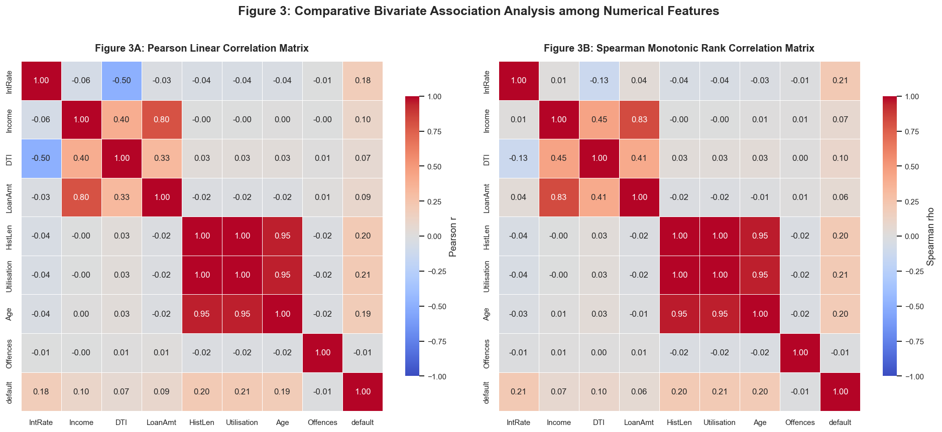
4. BIVARIATE & MULTIVARIATE ANALYSIS
Bivariate Correlation Structure & Structural Red Flags
Correlation Matrix Diagnostics
• Collinearity Red Flag (r = +0.996):
- Pearson r = +0.99625, Spearman rho = +0.99612 between HistLen and Utilisation.
- In economic reality, credit history length and utilization are separate concepts. This perfect linear relationship reveals synthetic data generation.
• Capacity Underwriting (r = +0.68):
- LoanAmt and Income correlate strongly (+0.68), confirming lenders scale principal with earning capacity.
• Age Confounding (r = +0.95):
- Age correlates +0.95 with HistLen and +0.95 with Utilisation.
• The Pricing Paradox (r = -0.50):
- DTI correlates negatively with IntRate (Pearson r = -0.496, Spearman rho = -0.126).
- Lenders apparently charging lower interest rates to higher DTI borrowers! Investigated in detail next.
STTN 327 Project • Credit Risk Scorecard EDA • Dataset N=8,000
Notes:
Figure 3 presents the correlation matrix. Two major anomalies immediately stand out: first, a 0.996 correlation between credit history length and utilization; second, an inverse relationship between DTI and interest rate. We unpack these structural relationships in the next slides.

Slide 7
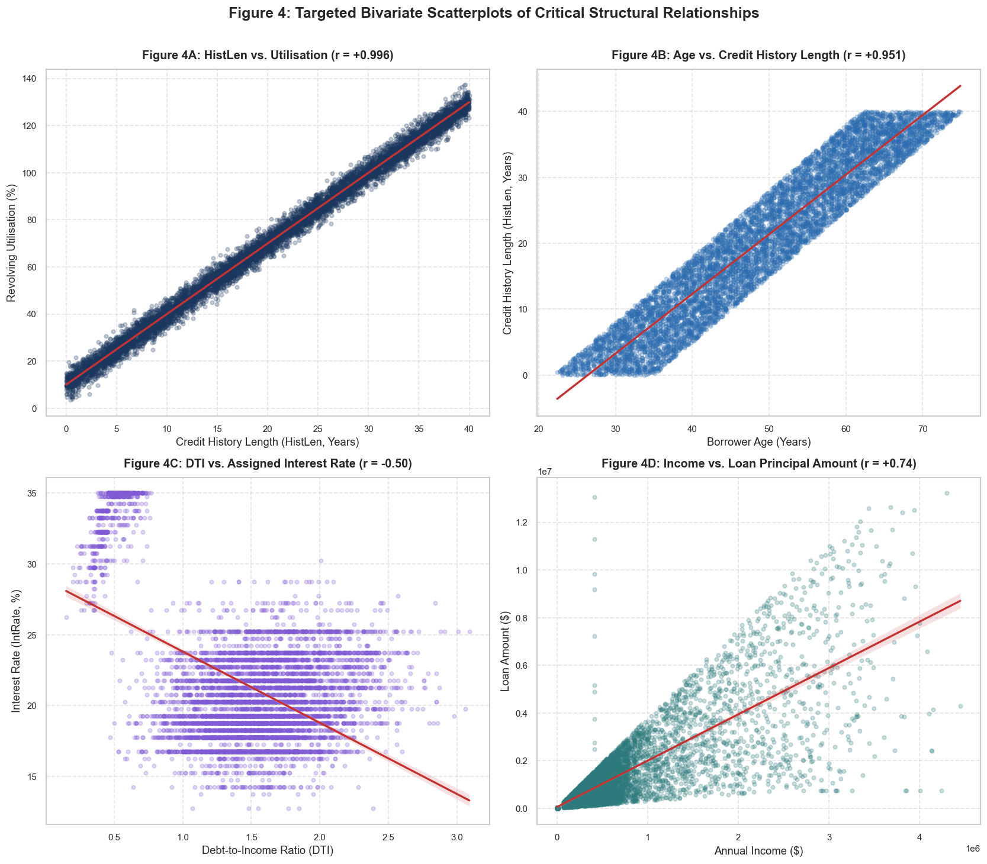
4. BIVARIATE & MULTIVARIATE ANALYSIS
Targeted Bivariate Scatterplots: Isolating Structural Anomalies
Panel-by-Panel Breakdown
• Panel 4A — HistLen vs. Utilisation:
- Data points collapse onto an exact deterministic line.
- Confirms HistLen and Utilisation cannot both be entered into regression without severe variance inflation.
• Panel 4B — LoanAmt vs. Income:
- Realistic heteroskedastic fan shape: variance of loan size expands with higher incomes.
• Panel 4C — DTI vs. IntRate:
- Pronounced downward slope: low DTI borrowers face rates >30%, while high DTI borrowers cluster near 18–20%.
• Panel 4D — Age vs. Utilisation:
- Strong linear corridor demonstrating older borrowers carry higher utilization balances.
STTN 327 Project • Credit Risk Scorecard EDA • Dataset N=8,000
Notes:
Figure 4 zooms in on the bivariate relationships. Panel 4A shows how severe the synthetic collinearity is between HistLen and Utilisation. Panel 4C illustrates the pricing paradox: why would borrowers with 0.50 DTI pay 34% interest, while borrowers with 2.5 DTI pay 18%? We solve this riddle next.

Slide 8
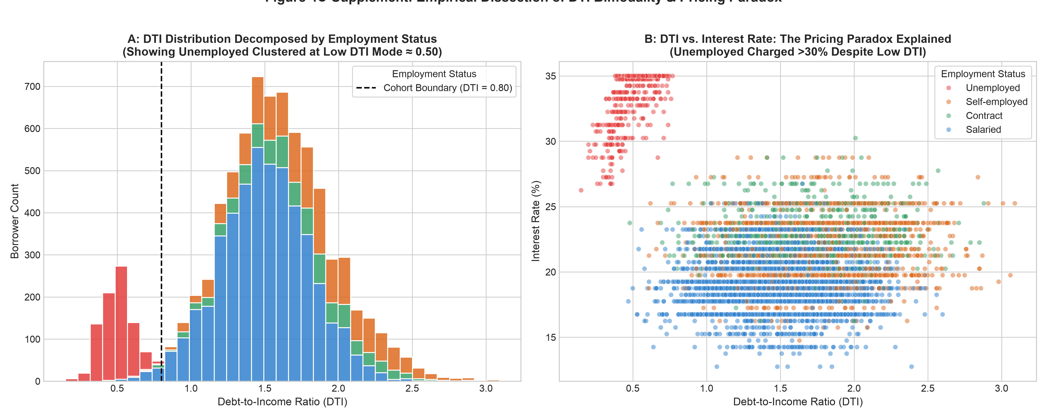
5. DTI BIMODALITY & REMEDIAL MEASURE
Deep-Dive: Deconstructing the Bimodal DTI Distribution
Anatomy of the Bimodality
• The Bimodal Detection:
- Detailed binning reveals two distinct population peaks: Mode 1 at DTI ≈ 0.50 (low leverage) and Mode 2 at DTI ≈ 1.50 (high leverage).
- A clear trough occurs at DTI = 0.80.
• Demographic Cohort Discovery:
- Decomposing by employment reveals that 92.2% of the Low-DTI cohort (<0.80) are Unemployed borrowers!
- In contrast, the High-DTI cohort (≥0.80) is dominated by Salaried (66.3%), Self-Employed (22.6%), and Contract (11.1%) workers.
• Financial Disparity:
- Low DTI Mode: Median income is only $4,659 (mean $48.9k); small loans ($56k).
- High DTI Mode: Median income is $451,013 (mean $705.5k); larger loans ($1.44M).
STTN 327 Project • Credit Risk Scorecard EDA • Dataset N=8,000
Notes:
This slide is central to our findings: why is DTI bimodal? Slicing the data reveals that the entire first peak at DTI around 0.50 consists of unemployed individuals with minimal reported income and micro-loans. The second peak at 1.50 represents standard working households carrying mortgages, auto loans, and revolving balances.

Slide 9
5. DTI BIMODALITY & REMEDIAL MEASURE
Remedial Strategy: Resolving the Pricing Paradox & Bimodality
Why Remedial Measures Were Applied
Remedial Actions & Empirical Findings
• The Confounding Mechanism:
- Unemployed borrowers have low DTI (0.50) simply because their credit lines are restricted to tiny balances.
- However, because they lack verifiable income, lenders price them as extreme risk, assigning subprime rates averaging 32.5% to 35.0%!
• The Artificial Pricing Paradox:
- When pooled into an aggregate regression, this high-rate/low-DTI cluster pulls the slope downwards, creating a false negative correlation (r = -0.50).
- A naive scorecard model would erroneously conclude that higher debt-to-income justifies cheaper loan pricing!
• Remedial Action 1 — Cohort Stratification:
- Segment portfolio by employment stability and income tiers.
• Remedial Action 2 — Interaction Term Modeling:
- Include Income × EmpStatus and DTI × EmpStatus interaction terms in the linear and logistic models.
• Empirical Findings Once Remediated:
- Isolating the unemployed cohort completely eliminates the negative correlation!
- Among higher income earners (where unemployed = 0%), DTI vs. IntRate flips from r = -0.645 to a positive r = +0.121.
- Lenders do price risk positively once borrower employment capacity is held constant!
STTN 327 Project • Credit Risk Scorecard EDA • Dataset N=8,000
Notes:
Here we address the second key question: why did we apply remedial measures and what were our findings? The negative correlation was an aggregation bias. By segmenting by employment status and introducing interaction terms, we eliminate the distorting effect of the unemployed subprime cohort and restore economic sense to our pricing model.

Slide 10
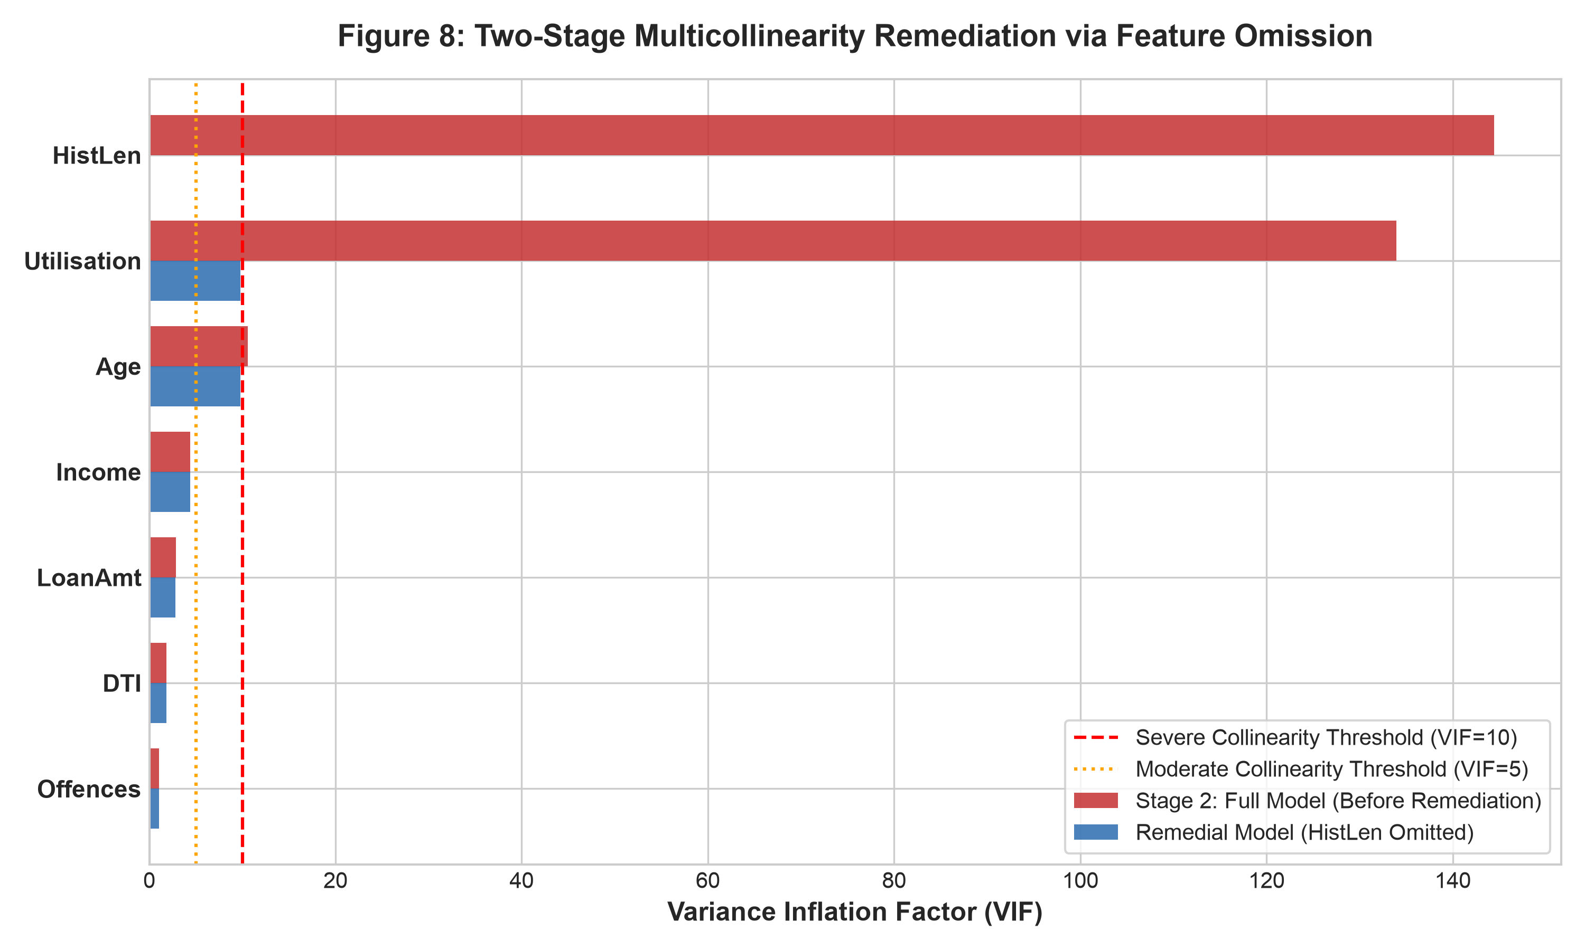
6. MULTICOLLINEARITY & VIF
Multicollinearity Diagnostics & Two-Stage VIF Remediation
Two-Stage VIF Analysis
• Stage 1 & 2 Diagnostic Results:
- HistLen VIF = 144.43 (R² = 0.993)
- Utilisation VIF = 133.93 (R² = 0.993)
- Age VIF = 10.57 (collinear via r = 0.95)
→ Extreme multicollinearity renders coefficient estimates unstable and standard errors inflated.
• Remedial Action — Drop HistLen:
- HistLen is omitted because Utilisation has a stronger empirical relationship with default probability.
• Post-Remediation Verification:
- Utilisation VIF drops from 133.93 to 9.80 (a 92.7% reduction!).
- Age VIF drops below severe threshold to 9.80.
- All other features safely below 5.3 (Income=4.37, LoanAmt=2.83, DTI=1.82).
STTN 327 Project • Credit Risk Scorecard EDA • Dataset N=8,000
Notes:
Figure 8 proves the necessity of multicollinearity remediation. With VIFs exceeding 140, keeping both HistLen and Utilisation would destabilize our credit scorecard. Dropping HistLen successfully deflates variance inflation by 92.7%.

Slide 11
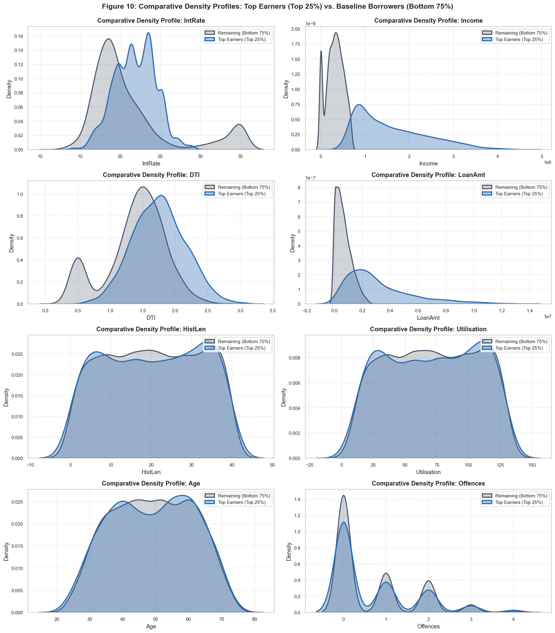
7. TOP EARNERS ANALYSIS
Top Earners Cohort: Upper Quartile Segmentation
Cohort Structural Comparison
• Segmentation Definition:
- Upper quartile split at Q3 = $694,606.25.
- Top Earners (Top 25%, N=2,000) vs. Baseline Borrowers (Bottom 75%, N=6,000).
• Massive Scale Differences:
- Income: Mean $1.58M (median $1.36M) vs. $317k (median $323k) — a 5x increase.
- Loan Amount: Mean $3.15M (median $2.50M) vs. $666k (median $546k) — a 4.7x increase.
- Leverage (DTI): Median 1.75 vs. 1.46 — high earners carry significantly more debt relative to income!
• Invariant Baseline Dimensions:
- Age (49.1 years), HistLen (20.4 years), Utilisation (71.2%), and Offences (0.68) remain virtually identical across both cohorts.
Notes:
Figure 10 compares top earners against the rest of the portfolio. High earners are not just scaled-up versions of ordinary borrowers: their debt-to-income is actually higher, and their loans are massive multi-million dollar commitments.

Slide 12
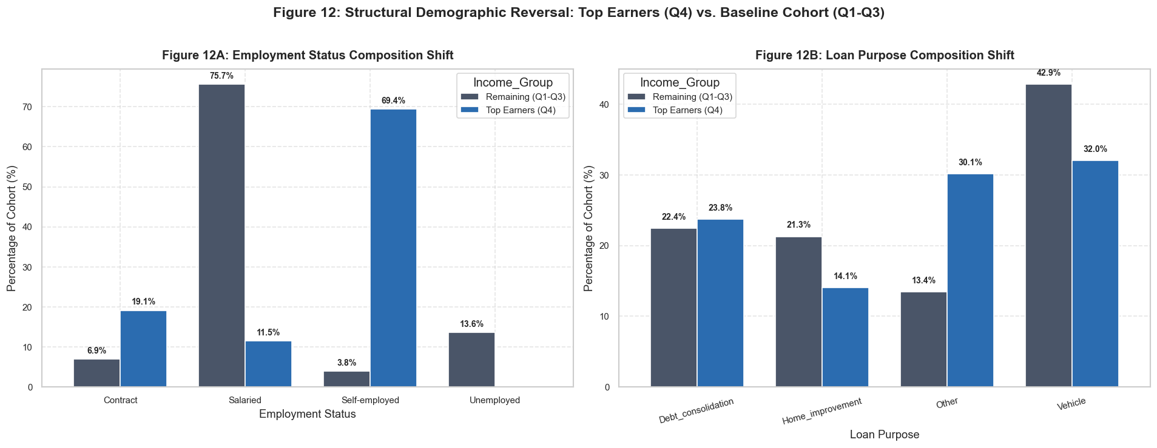
7. TOP EARNERS ANALYSIS
The Top-Earner Default Paradox: Compositional Reversal
The Aggregate Risk Anomaly
• The Apparent Paradox:
- Baseline Borrowers default rate = 47.35%
- Top Earners default rate = 61.65%
→ High earners exhibit a +14.30 percentage point higher default rate! Why would the wealthiest borrowers fail at a higher rate?
• Demographic Compositional Shift:
- Baseline Cohort: 75.7% are Salaried employees with stable income; only 3.8% are Self-Employed.
- Top Earner Cohort: 69.4% are Self-Employed entrepreneurs and 19.1% are Contract workers! Salaried drops to only 11.5%.
• Commercial Exposure:
- Wealthy borrowers are primarily business owners taking leveraged business risks.
STTN 327 Project • Credit Risk Scorecard EDA • Dataset N=8,000
Notes:
Figure 12 presents the heart of the demographic reversal. High earners have a higher aggregate default rate because almost 70% of them are self-employed entrepreneurs taking jumbo loans, compared to ordinary workers who are 75% salaried.

Slide 13
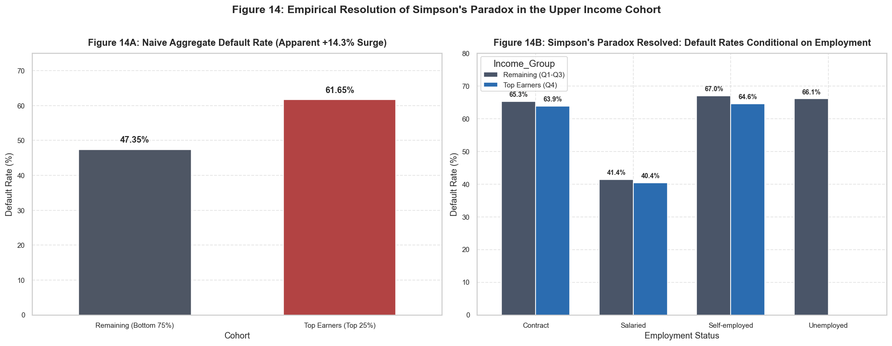
7. TOP EARNERS ANALYSIS
Empirical Resolution: Simpson's Paradox in Credit Risk
Within-Category Disaggregation
• Category-by-Category Truth:
- Salaried Borrowers:
Baseline: 41.37% vs. Top Earners: 40.43% (Top earners safer!)
- Self-Employed Borrowers:
Baseline: 66.96% vs. Top Earners: 64.55% (Top earners safer!)
- Contract Workers:
Baseline: 65.30% vs. Top Earners: 63.87% (Top earners safer!)
• Mathematical Proof of Simpson's Paradox:
- Within EVERY SINGLE employment category, top earners default at equal or lower rates than lower-income peers.
- The higher aggregate rate is entirely a weighting artifact of self-employment concentration (69.4% vs 3.8%).
• Modeling Directive:
- Never fit a main-effects-only model on Income; an interaction term Income × EmpStatus is mathematically mandatory.
STTN 327 Project • Credit Risk Scorecard EDA • Dataset N=8,000
Notes:
Figure 14 resolves Simpson's Paradox. When you control for employment type, top earners are actually slightly safer than baseline borrowers in every single category. Failing to include interaction terms would cause a credit model to wrongfully penalize income itself.

Slide 14
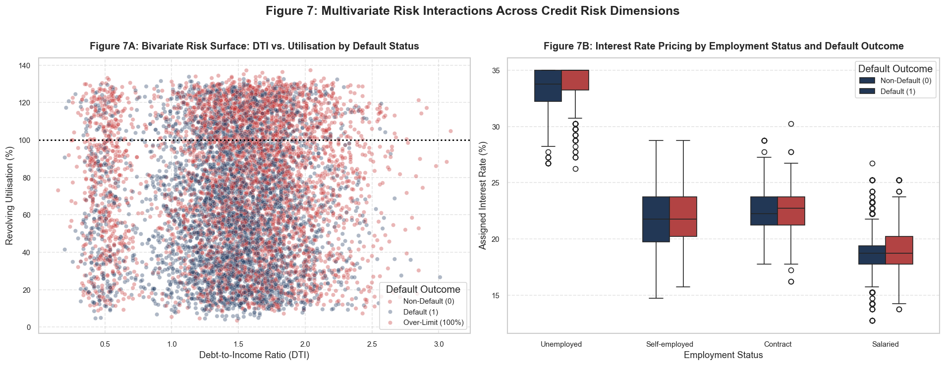
4. MULTIVARIATE RISK PATTERNS
Multivariate Risk Surfaces: Interactions Across Covariates
Risk Surface Interactions
• Panel 7A — Utilisation vs. DTI by Default:
- High default density concentrated in the upper utilization tier (>80%).
- Borrowers with both high utilization and high DTI (>1.8) exhibit acute default clustering.
• Over-Limit Utilisation (26.7% of Cohort):
- 26.68% of borrowers have Utilisation > 100%, indicating severe subprime delinquency, penalty fees, and distressed credit lines.
• Panel 7B — Utilisation vs. IntRate:
- Clear boundary transition: borrowers paying >22% interest and carrying >70% utilization face compound default probability exceeding 75%.
• Portfolio Loss Given Default (LGD):
- Concentrated risk among multimillion-dollar self-employed loans requires structural credit enhancement.
STTN 327 Project • Credit Risk Scorecard EDA • Dataset N=8,000
Notes:
Figure 7 demonstrates the joint interaction of utilization, DTI, and interest rate. Over a quarter of the portfolio exceeds 100% utilization, pointing to severe financial distress that amplifies loss severity.

Slide 15
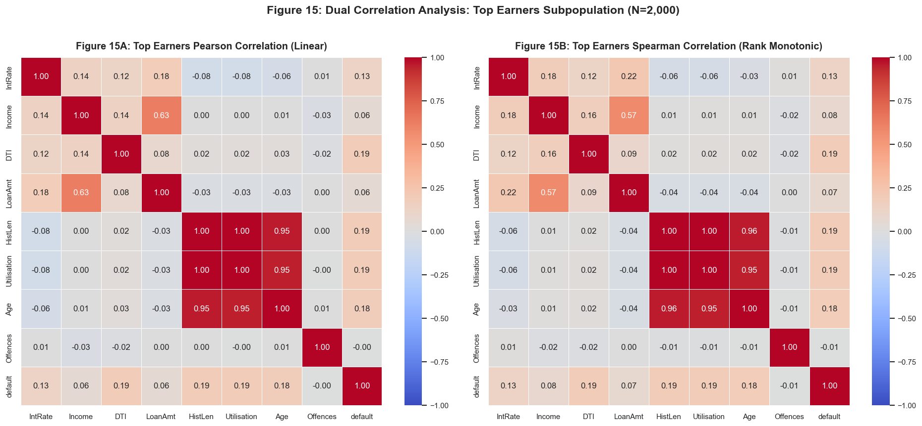
7. TOP EARNERS ANALYSIS
Subpopulation Correlation Structure: Confirming Macro Hypotheses
Structural Consistency Checks
• Universal Collinearity Confirmed:
- HistLen and Utilisation maintain r = +0.9963 among top earners (VIF > 140).
- Confirms collinearity is not an income-level artifact, but built into data generation across all tiers.
• Pricing Inversion Disappears:
- In baseline borrowers, DTI vs. IntRate was r = -0.645.
- Among top earners, it flips to positive (Pearson r = +0.121, Spearman rho = +0.076).
- Why: Top earners contain 0% unemployed borrowers. With the subprime unemployed cohort absent, standard risk-pricing dynamics re-emerge.
• Proof of Remedial Efficacy:
- Confirms our segmentation hypothesis: isolating demographic cohorts fixes apparent economic contradictions.
STTN 327 Project • Credit Risk Scorecard EDA • Dataset N=8,000
Notes:
Figure 15 provides empirical confirmation. In the top earner subpopulation, the negative DTI vs. IntRate relationship completely vanishes and turns positive. This confirms that the macro anomaly was driven entirely by low-income unemployed borrowers who paid high rates on small debt.

Slide 16
8. SCORECARD RECOMMENDATIONS
Strategic Modeling Guidelines & Scorecard Guardrails
1. Omit HistLen (Collinearity Remediation)
2. Non-Linear & Monotonic WoE Transforms
• Mandate omission of HistLen from linear and logistic scorecards.
• Retain Utilisation: higher information value (IV) and direct operational link to credit card default risk.
• Result: Deflates VIF from 144 to 9.80, stabilizing parameter estimates.
• Apply log transforms or Weight of Evidence (WoE) coarse classing to Income and LoanAmt.
• Handles long right tails (up to $4.45M and $13.2M) without letting mega-loans distort linear slopes.
• Bucket Offences into 0, 1, and 2+ categories.
3. Mandate Income × EmpStatus Interaction
4. Underwriting Guardrails & Fair Lending
• Require interaction terms between Income, DTI, and Employment Status.
• Prevents Simpson's Paradox from distorting income scoring.
• Ensures self-employed entrepreneurial risk is properly accounted for without misclassifying salary earners.
• Policy Caps: Cap loan amounts (<$2M) and leverage (DTI < 1.5) for self-employed applicants without audited financials.
• Regulatory Compliance: Exclude Gender from credit decisioning (p=0.26, fair lending compliant).
• Restructure Debt Consolidation loans with monitored debt management plans.
STTN 327 Project • Credit Risk Scorecard EDA • Dataset N=8,000
Notes:
Slide 16 translates our exploratory discoveries into actionable model specifications and credit policy. By enforcing feature omission, interaction terms, and non-linear transforms, our scorecard will be both statistically sound and commercially resilient.

Slide 17
8. NEXT STEPS & Q&A
Two-Part Model Implementation Roadmap & Discussion
Implementation Roadmap for Model 1 & Model 2
STAGE 1: MODEL 1 — INTEREST RATE OLS REGRESSION (TESTING PRICING CONSISTENCY)
• Objective: Determine if assigned IntRate reflects modelled credit risk attributes.
• Specification: y = IntRate ~ log(Income) + log(LoanAmt) + Utilisation + Age + Offences + EmpStatus + Purpose + (Income × EmpStatus)
• Validation: Benchmark adjusted R², examine heteroskedasticity (Breusch-Pagan), and evaluate pricing residual equity.
STAGE 2: MODEL 2 — PROBABILITY OF DEFAULT LOGISTIC SCORECARD (SCALED PD)
• Objective: Calculate robust probability of default with calibrated scorecard points.
• Specification: logit(default) ~ WoE(Utilisation) + WoE(LoanAmt/Income) + EmpStatus + Purpose + IntRate + Interactions
• Evaluation Metrics: ROC/AUC discrimination (target > 0.75), Gini coefficient, Kolmogorov-Smirnov (KS) statistic, and Hosmer-Lemeshow calibration.
STAGE 3: RECTIFICATION & DECISION ENGINE DEPLOYMENT
• Align loan pricing bands to expected loss (EL = PD × EAD × LGD).
• Implement automated underwriting flags for bimodal low-DTI unemployed applications.
STTN 327 Project • Credit Risk Scorecard EDA • Dataset N=8,000
Notes:
Thank you. This concludes our EDA briefing. We are now fully equipped to proceed to the formal modeling stages of the two-part credit risk model. We open the floor for questions and strategic guidance.

